Slide 1
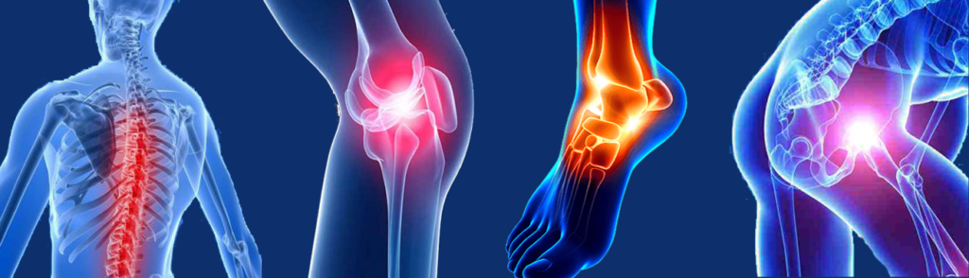
PostOp Pal
Notes:
Good evening. Welcome to the final presentation of my project – PostOp Pal.

Slide 2
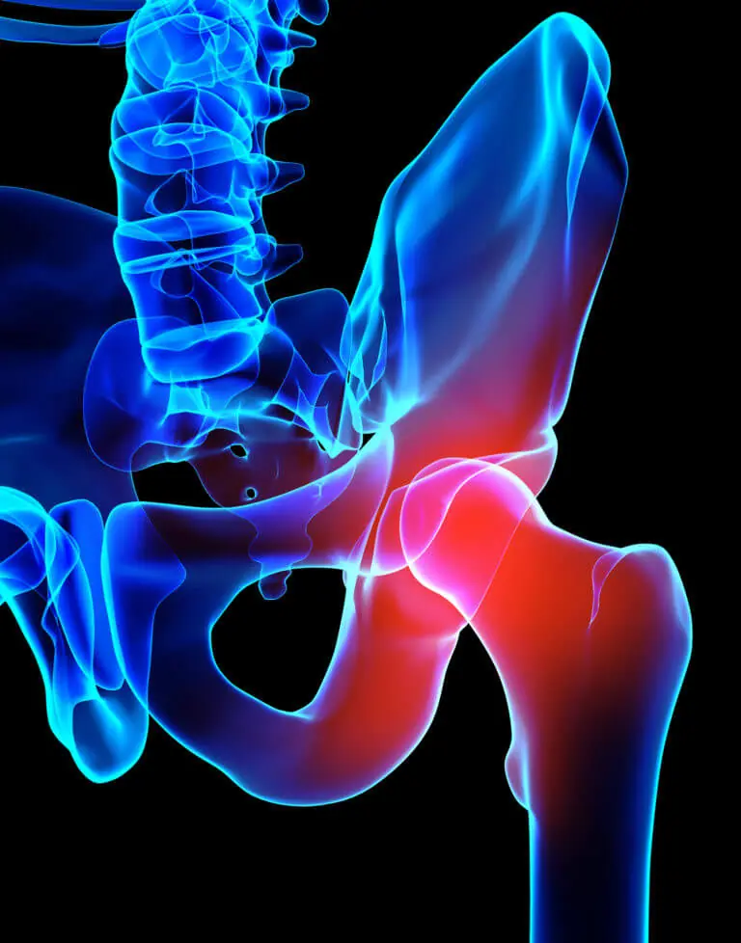
Gap in Care
Underserved population
Un-insured or under-insured
QUALITY Gap
Lack of access to resources
Informatics problem
Static home program
Notes:
For patients who come to the hospital with no insurance or have limited benefits from insurance.
There are over 25 million people in the US that fall into this category. About 1.2 million in Georgia, which is 12% of the total population. At least 1 in 10 patients coming into the hospitals fall into this category
Some do not have access or cannot afford to get to outpatient appointments to continue their rehab at home after leaving the hospital.
Without regular follow up, patients are at risk for complications and readmissions, all of which are costly.
The are often faced with overwhelming amounts of information to navigate their post-operative recovery. They have handouts with a few pictures and lots of instructions, but no further information to aide in recovery.

Slide 3
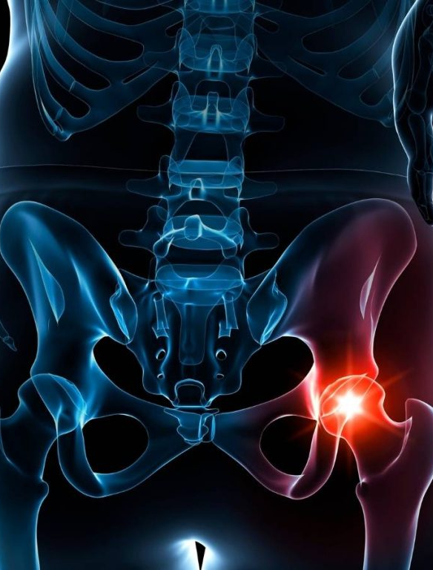
PostOp Pal
LOW COST ACCESSIBILITY
Digital bridge
DYNAMIC GUIDANCE
Phased progressive home program
Inherent safety reminders
ACTIVE MONITORING
Post-Op Care Instructions
Precautions reminder
JUDITH SOUTHARD, PT, DPT
Notes:
PostOp Pal provides a digital bridge using easily accessible software that has little to no cost.
There is dynamic guidance of a home program. It’s individualized based on .the type of surgery and the phase of recovery, which is automatically calculated. The program also provides randomly selected fall risk reduction reminders and performs a quick safety check to ensure you are ready to begin the post-op program.
For total hip replacement patients, PostOp Pal also provides reminder of precautions based on which direction the hip was replaced.

Slide 4
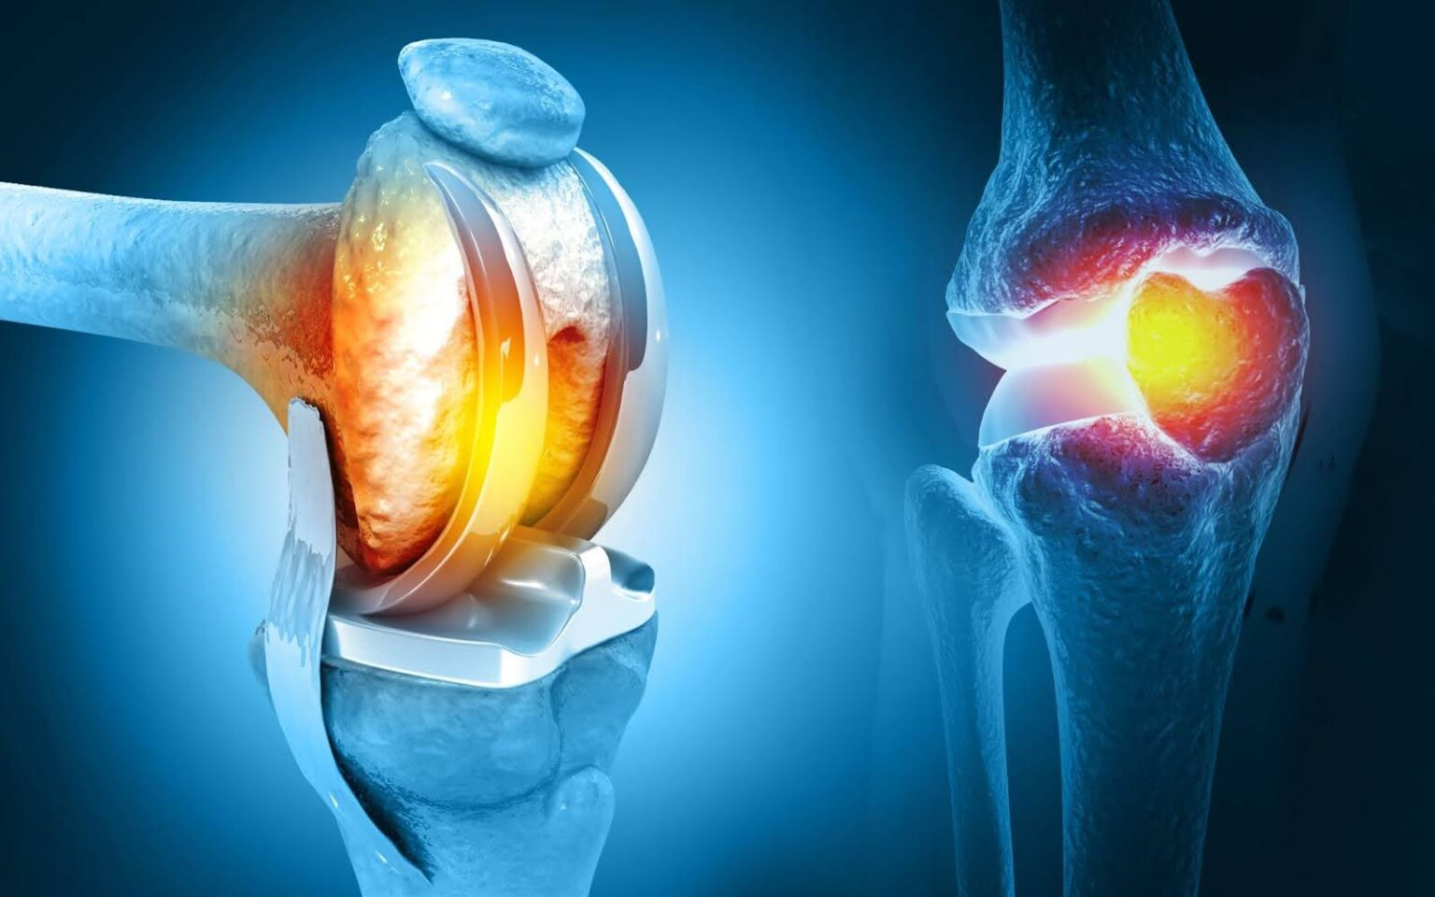
PostOp Pal
Python Code
GitHub - jsouth32/Judith-Southard-2026-HMI: Repository for HMI7540 · GitHub
JUDITH SOUTHARD, PT, DPT
Notes:
Then you remember that your physical therapist gave you a program that you can use to help you and your caregiver – PostOp Pal
It’s one simple, easy, customized solution
A program that will guide you through your post-operative phases of rehab
An individualized home program specific to your surgery that can progress your exercises.
Post-op care instructions for pain management like positioning ideas or modalities
The do’s and don’ts on which way you cannot move your leg after surgery
Reminder prompts to complete your exercise program, change position, and
Other helpful tips and tricks to maximize your recovery
All of this in one easy program.

Slide 5
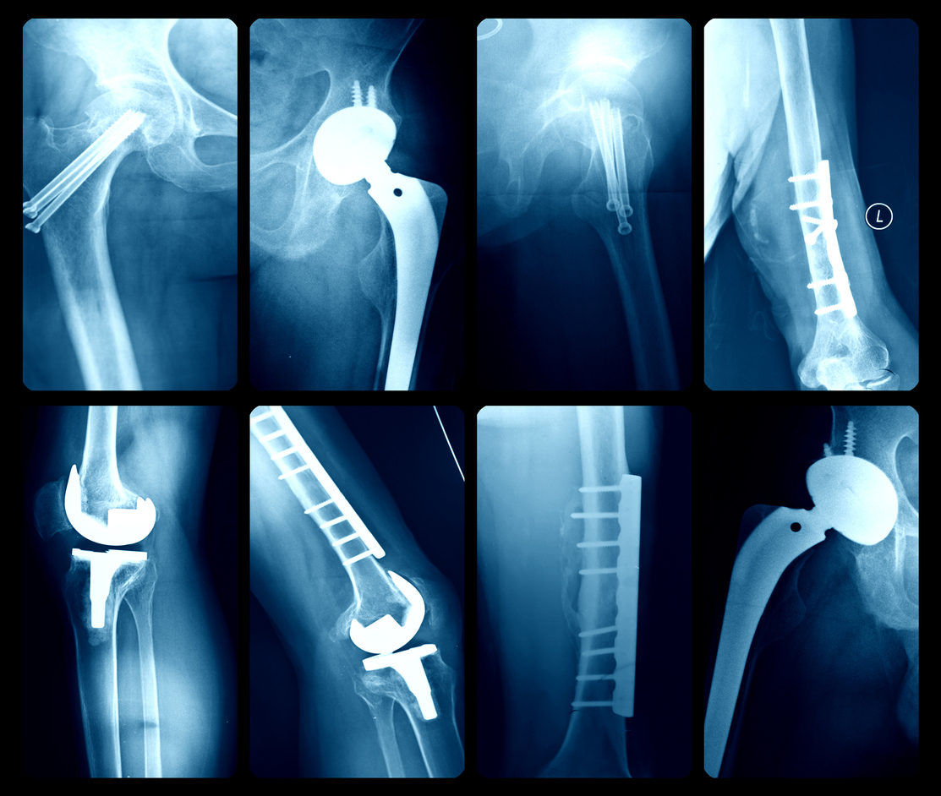
Thank you
Notes:
Now I turn to you – the board of directors
Will you continue to send patients home without the proper tools? When we do this, we aren’t sending them home to recover, we are leaving them to struggle
Those patients are at a high risk of readmission.
PostOp Pal isn’t just an expense or a budget line item approval.
You will directly prevent complications for our most vulnerable patients who could be your neighbor.
Let’s make sure everyone you care about has the support they need.
Thank you. Any questions?
*For development, design, operating cost, and ongoing maintenance, $125,000.

